Slide 1

Banking Management System
By- Tanuj Chaudhuri(12021002016059)-17
Nilanjan Bhattacharya(12021002016054)- 22
Shubhajit Biswas(22022002016016)-66

Slide 2
Overview
Banking management systems (BMS) are crucial software applications that streamline the daily operations of banks. They facilitate customer account tracking, transaction processing, and comprehensive reporting. Java, a robust and versatile programming language, is widely preferred for developing BMS due to its object-oriented approach, platform independence, and inherent reliability.

Slide 3
Introduction
A banking management system (BMS) is a comprehensive software application designed to manage the day-to-day operations of a bank. It encompasses various functionalities, including:
Account Management
Transaction Processing: Deposit and withdrawal of funds
Account Information: Real-time access to account balances, transaction history, and account details

Slide 4
Components of a Banking Management System
A typical banking management system comprises the following core components:
Application Server: The backbone of the system, providing the logic for processing transactions, managing accounts, and enforcing security measures.
User Interface: The interactive front-end that allows bank employees and customers to interact with the system, perform tasks, and access information.

Slide 5
Example of a Banking Management System Developed in Java
A simplified Java-based banking management system might include the following features:
Deposit and Withdrawal: Enable users to deposit and withdraw funds from their respective accounts, validating transaction amounts and account balances.
Balance Inquiries: Provide users with real-time access to their account balances, ensuring up-to-date information.
Transaction History: Provide users with a detailed history of their transactions, including dates, amounts, and transaction types.

Slide 6
Advantages of Java
Java Programming Language for Banking Management Systems
Java is a popular choice for developing banking management systems due to its:
Object-oriented programming paradigm: Enables developers to create modular and reusable code.
Platform independence: Java applications can run on any platform that has a Java Virtual Machine (JVM).
Robustness: Java provides strong memory management and exception handling, making it a reliable choice for critical applications like banking management systems.

Slide 7
Benefits of Using a Banking Management System
Banking management systems offer a plethora of benefits to banks, including:
Enhanced Efficiency: Automate manual tasks, reduce errors, and streamline processes, leading to faster transaction processing and improved efficiency.
Cost Reduction: Automate operations, minimize labor costs associated with manual tasks, and optimize resource allocation, resulting in significant cost savings.
Improved Customer Service: Provide customers with self-service options, real-time account information, and convenient access to their financial data, enhancing customer satisfaction and loyalty.
Data-Driven Decision-Making: Generate comprehensive reports and perform data analysis to gain insights into customer behavior, identify trends, and make informed strategic decisions.
Compliance Management: Facilitate compliance with regulatory requirements, ensuring adherence to financial regulations and data protection standards.

Slide 8
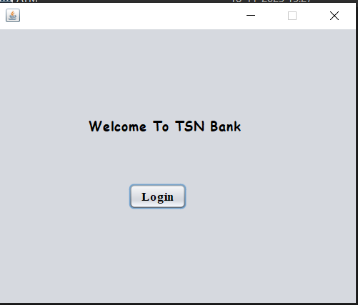
LOGIN PAGE

Slide 9
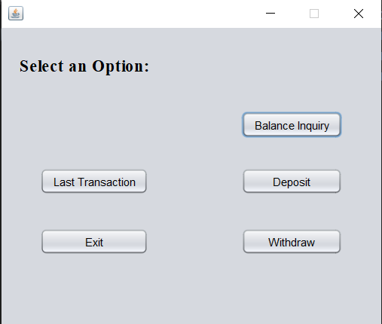
Home Page

Slide 10
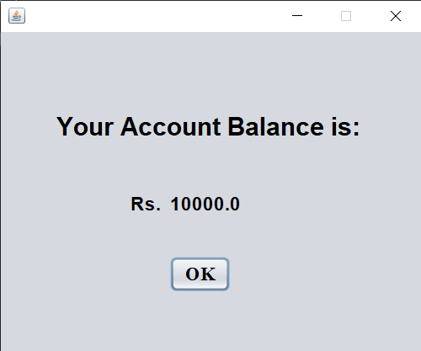
Balance

Slide 11
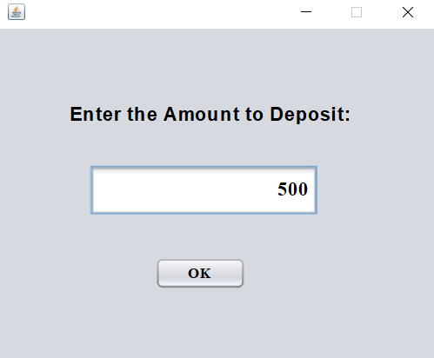
Deposit

Slide 12
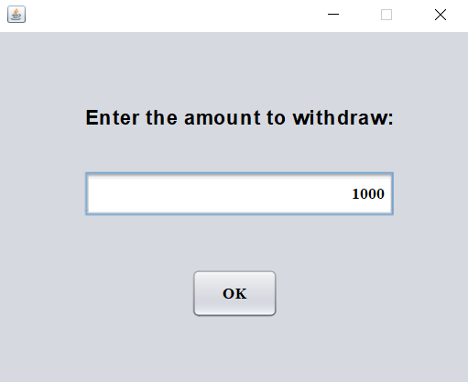
Withdraw

Slide 13
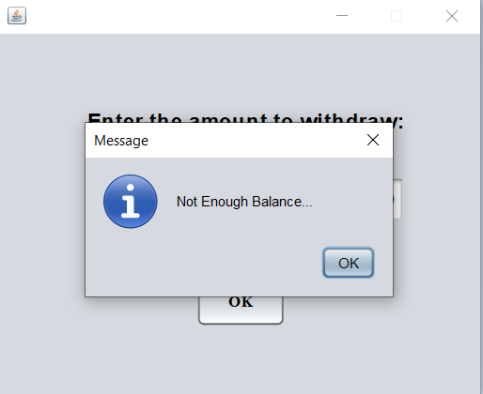
Insufficient Balance

Slide 14
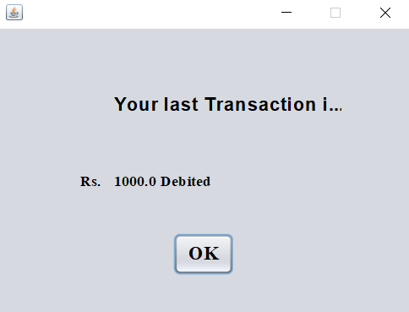
Last Transaction

Slide 15
Conclusion
Banking management systems are essential tools for modern banks.
By utilizing Java's powerful features, banks can develop efficient, reliable, and scalable systems to manage their operations and provide superior customer service.

